Slide 1
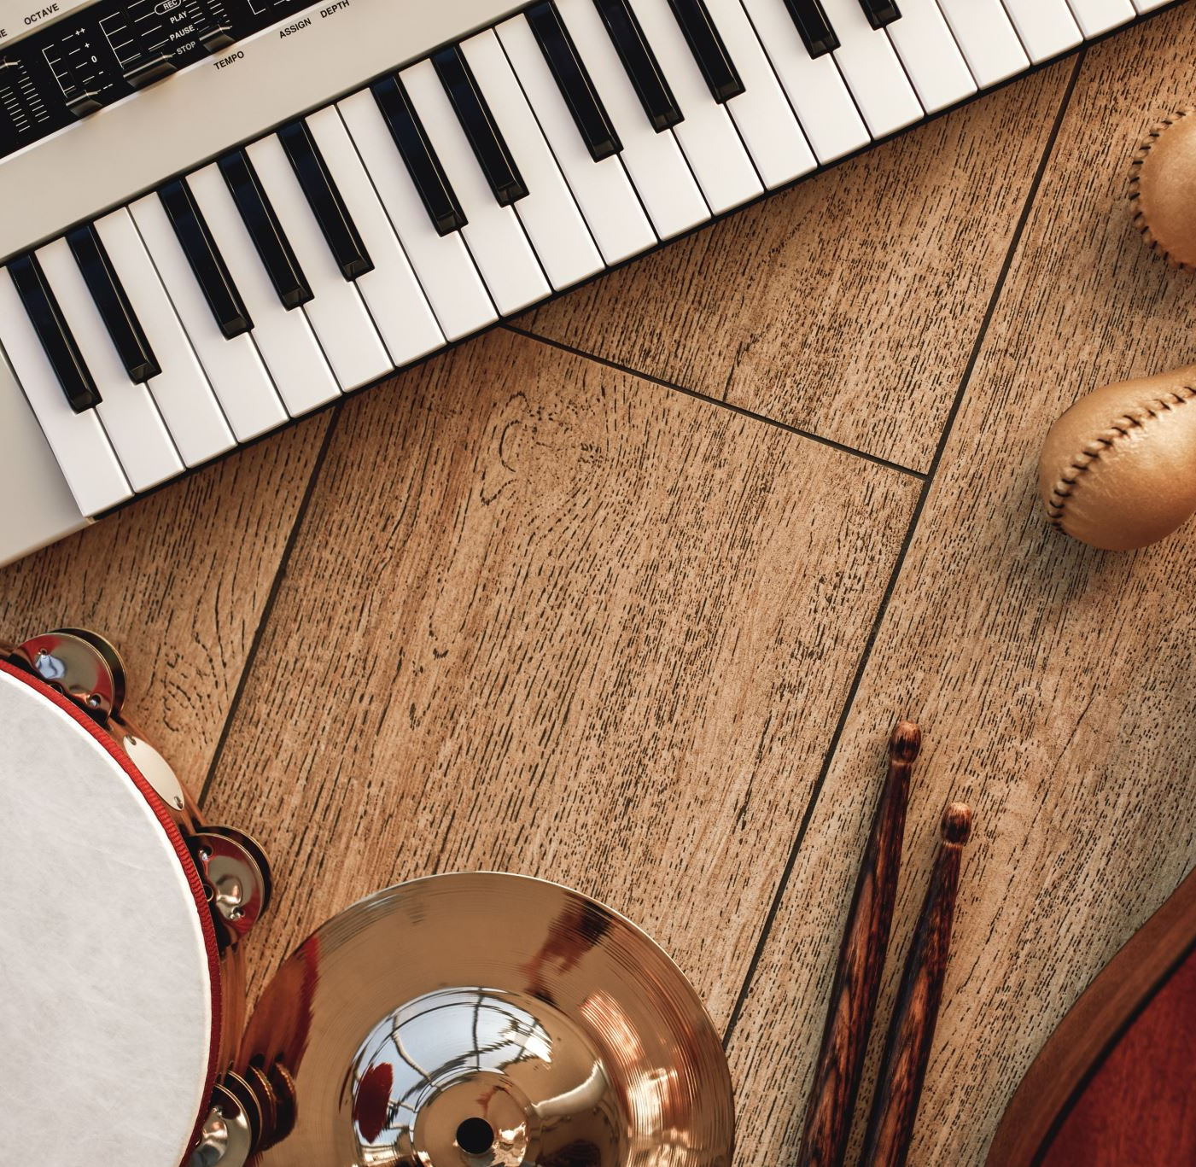
Music and the mind
project presentation group 3

Slide 2

Introduction: The Power of Music
Music has a strong effect on most people
How it acts on the brain is therefore of general interest
New field in of research: Music Information Retrieval (MIR)

Slide 3
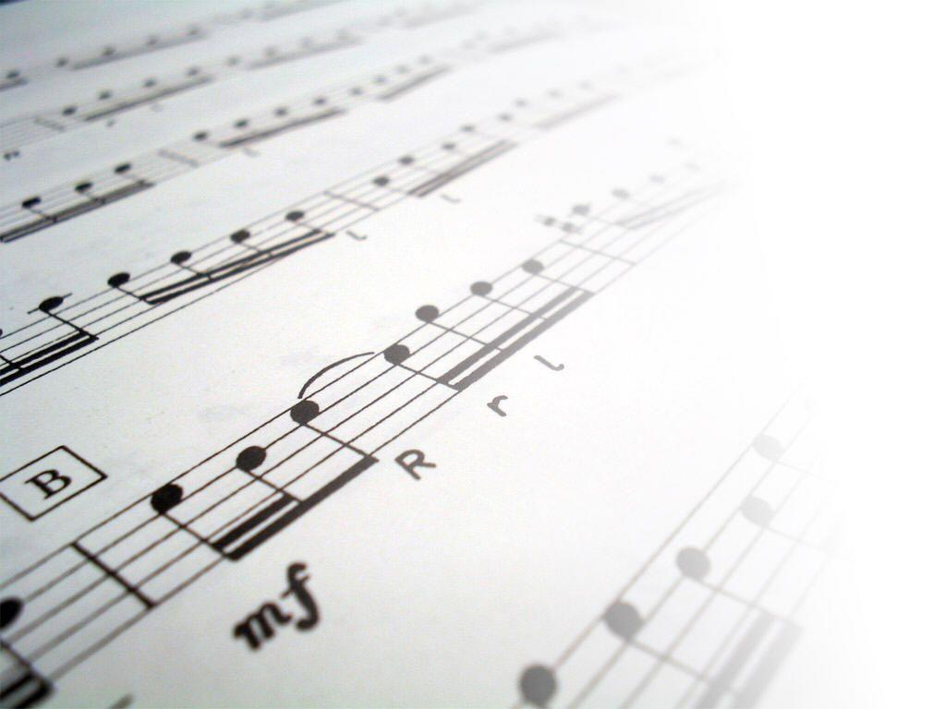

The data – basic facts
The data for our project is taken from the OpenMIIR dataset
Available at https://github.com/sstober/openmiir
Collected at the University of Potsdam, Germany
Several subjects listened to or imagined short music fragments while their EEG data was recorded

Slide 4
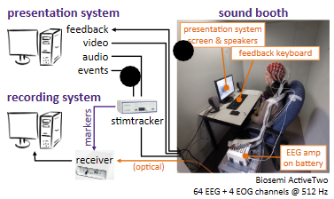
The data - subjects
10 participants
3 male, 7 female, mostly early 20s
Selected via beat test and familiarity with the stimuli
Participants filled in a questionnaire answering questions about their musical education, whether they played an instrument and so on
Stober, Sebastian et al. “Towards Music Imagery Information Retrieval: Introducing the OpenMIIR Dataset of EEG Recordings from Music Perception and Imagination.” International Society for Music Information Retrieval Conference (2015), p. 765

Slide 5

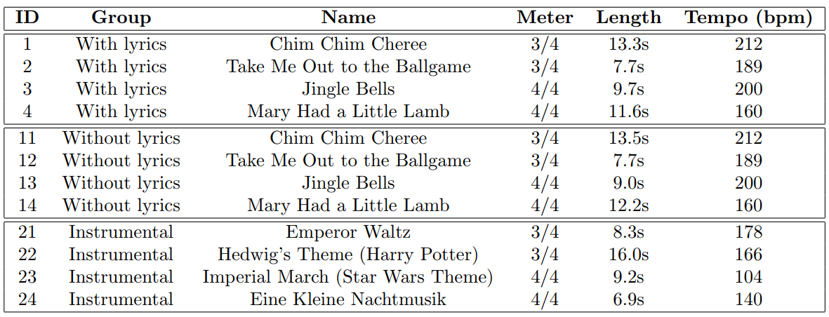
The data - music

Slide 6
The data - conditions
(1) Stimulus perception preceded by cue clicks
(2) Stimulus imagination preceded by cue clicks
(3) Stimulus imagination without cue clicks
(4) Stimulus imagination without cue clicks, with feedback

Slide 7
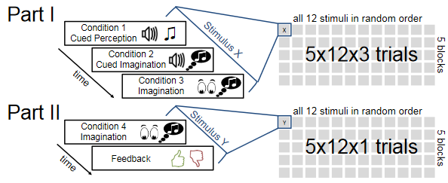
The data – trials
Recordings took place in an audiometric room
64+2 EEG channels at 512 Hz
240 trials per participant: 12 stimuli x 4 conditions x 5 blocks
Conditions 1, 2, and 3 recorded on the same day, condition 4 recorded on a later date
Stimuli were randomized within each block
Stober, Sebastian et al. “Towards Music Imagery Information Retrieval: Introducing the OpenMIIR Dataset of EEG Recordings from Music Perception and Imagination.” International Society for Music Information Retrieval Conference (2015), p. 766

Slide 8
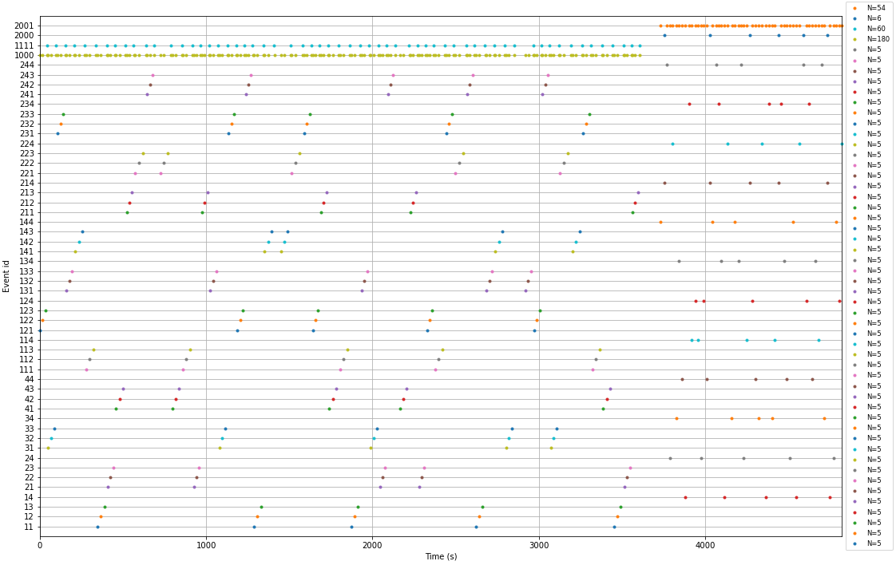
Events along a time axis for subject ‘P01’

Slide 9
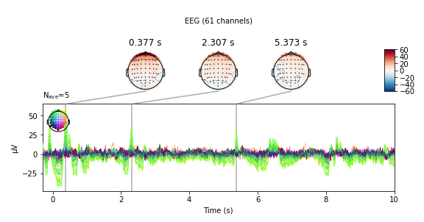
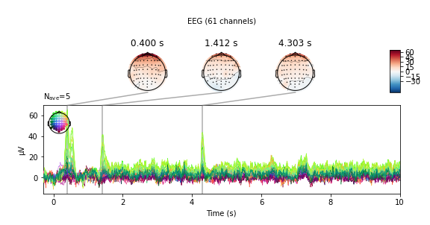
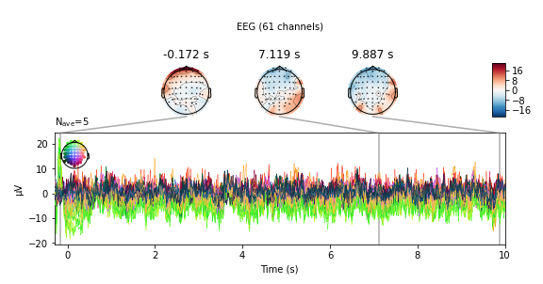
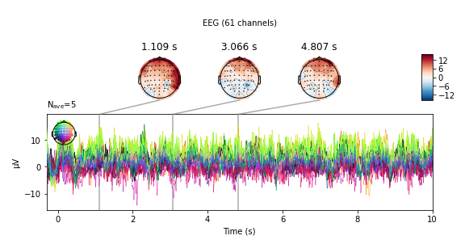
Averaged signals for ‘P01’
condition 1
condition 2
condition 3
condition 4

Slide 10
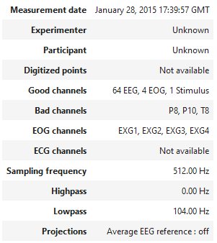
The project - raw.info for subject ‘P01’

Slide 11

Our project

Slide 12
The project – research questions
EEG response investigated for:
Music with lyrics vs. music without lyrics
Music that is actually heard vs. music that is imagined
Data used:
Mode 1: Data from one participant for all pieces of music
Mode 2: Data from all participants for the same piece of music
Questions we asked:
Can we train an AI to tell the difference?
Which classifier works better?

Slide 13
The project – libraries
numpy
matplotlib
mne
sklearn
seaborn
pyriemann

Slide 14
The project – preprocessing
Cleanup
Remove ambiguous EEG channels
Interpolate bad EEG channels
Filter
Apply a bandpass filter of 1 Hz – 40 Hz
Downsample from 512 Hz to 64 Hz
Other
Average
Chunk, shift events by 3 seconds and create epochs

Slide 15
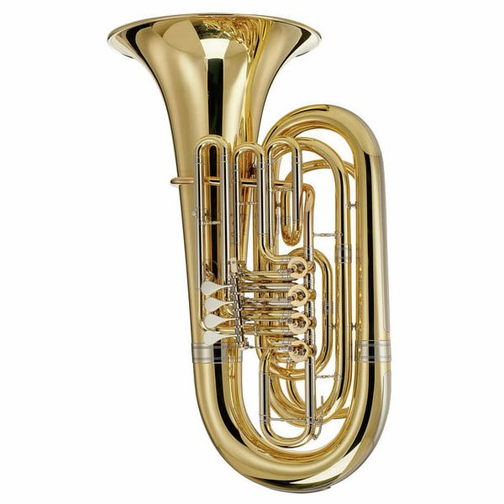
The project – pipelines
SVC
support vector machine classifier, includes PCA, CSP and ScandardScalar
LDA
linear discriminant analysis classifier, includes PCA, CSP and ScandardScalar
Tangentspace
support vector machine classifier, in conjunction with the Riemann metric
MDM
classifier based on minimum distance to mean

Slide 16
The project – running the experiments
We used 10-fold cross validation for our training and testing
We visualized our results with box plots and confusion matrices

Slide 17

Our results

Slide 18
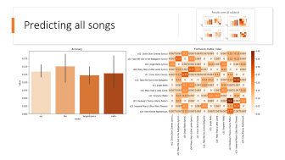
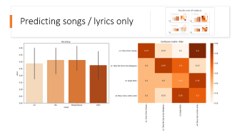
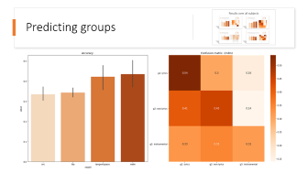
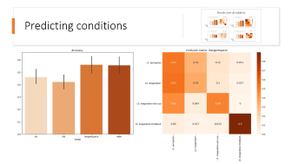




Results over all subjects

Slide 19
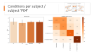
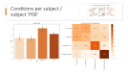
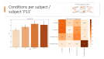
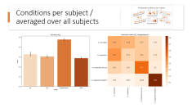
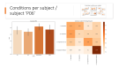
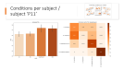
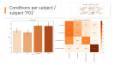
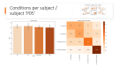
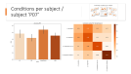
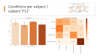


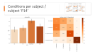
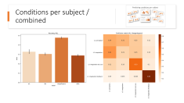

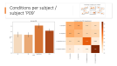
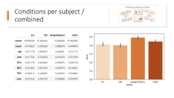






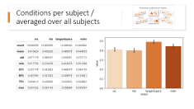
Predicting conditions per subject

Slide 20
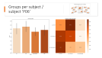
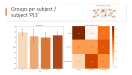
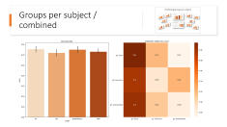
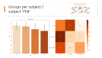
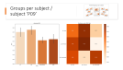
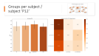

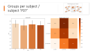
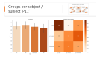
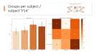


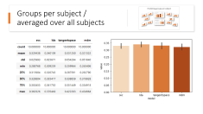



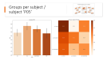







Predicting groups per subject

Slide 21
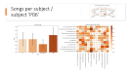
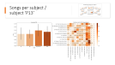
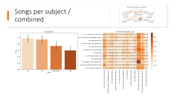
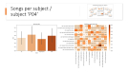
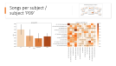
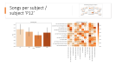
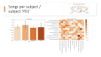
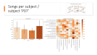
















Predicting songs per subject

Slide 22

Challenges
Expectations vs. reality
The data set is very large (6.5 GB)
The events are very long
The data includes cue clicks
The trials for condition 4 were done on a different day than the others, which made them noticeably different

Slide 23

Thank you for your attention!

Slide 24

Outlook & discussion

Slide 25

Oops, you went too far ;)

Slide 26
Overall predictions

Slide 27



Predicting conditions

Slide 28

Predicting groups

Slide 29

Predicting all songs

Slide 30

Predicting songs / lyrics only

Slide 31
Predicting conditions per subject

Slide 32



Conditions per subject / subject ‘P01’

Slide 33

Conditions per subject / subject ‘P04’

Slide 34

Conditions per subject / subject ‘P05’

Slide 35

Conditions per subject / subject ‘P06’

Slide 36

Conditions per subject / subject ‘P07’

Slide 37

Conditions per subject / subject ‘P09’

Slide 38

Conditions per subject / subject ‘P11’

Slide 39

Conditions per subject / subject ‘P12’

Slide 40

Conditions per subject / subject ‘P13’

Slide 41

Conditions per subject / subject ‘P14’

Slide 42

Conditions per subject / combined

Slide 43


Conditions per subject / averaged over all subjects

Slide 44
Predicting groups per subject

Slide 45



Groups per subject / subject ‘P01’

Slide 46

Groups per subject / subject ‘P04’

Slide 47

Groups per subject / subject ‘P05’

Slide 48

Groups per subject / subject ‘P06’

Slide 49

Groups per subject / subject ‘P07’

Slide 50

Groups per subject / subject ‘P09’

Slide 51

Groups per subject / subject ‘P11’

Slide 52

Groups per subject / subject ‘P12’

Slide 53

Groups per subject / subject ‘P13’

Slide 54

Groups per subject / subject ‘P14’

Slide 55

Groups per subject / combined

Slide 56


Groups per subject / averaged over all subjects

Slide 57
Predicting songs per subject

Slide 58



Songs per subject / subject ‘P01’

Slide 59

Songs per subject / subject ‘P04’

Slide 60

Songs per subject / subject ‘P05’

Slide 61

Songs per subject / subject ‘P06’

Slide 62

Songs per subject / subject ‘P07’

Slide 63

Songs per subject / subject ‘P09’

Slide 64

Songs per subject / subject ‘P11’

Slide 65

Songs per subject / subject ‘P12’

Slide 66

Songs per subject / subject ‘P13’

Slide 67

Songs per subject / subject ‘P14’

Slide 68

Songs per subject / combined

Slide 69


Songs per subject / averaged over all subjects

Slide 70
Oops, you went too far ;)

